Slide 1

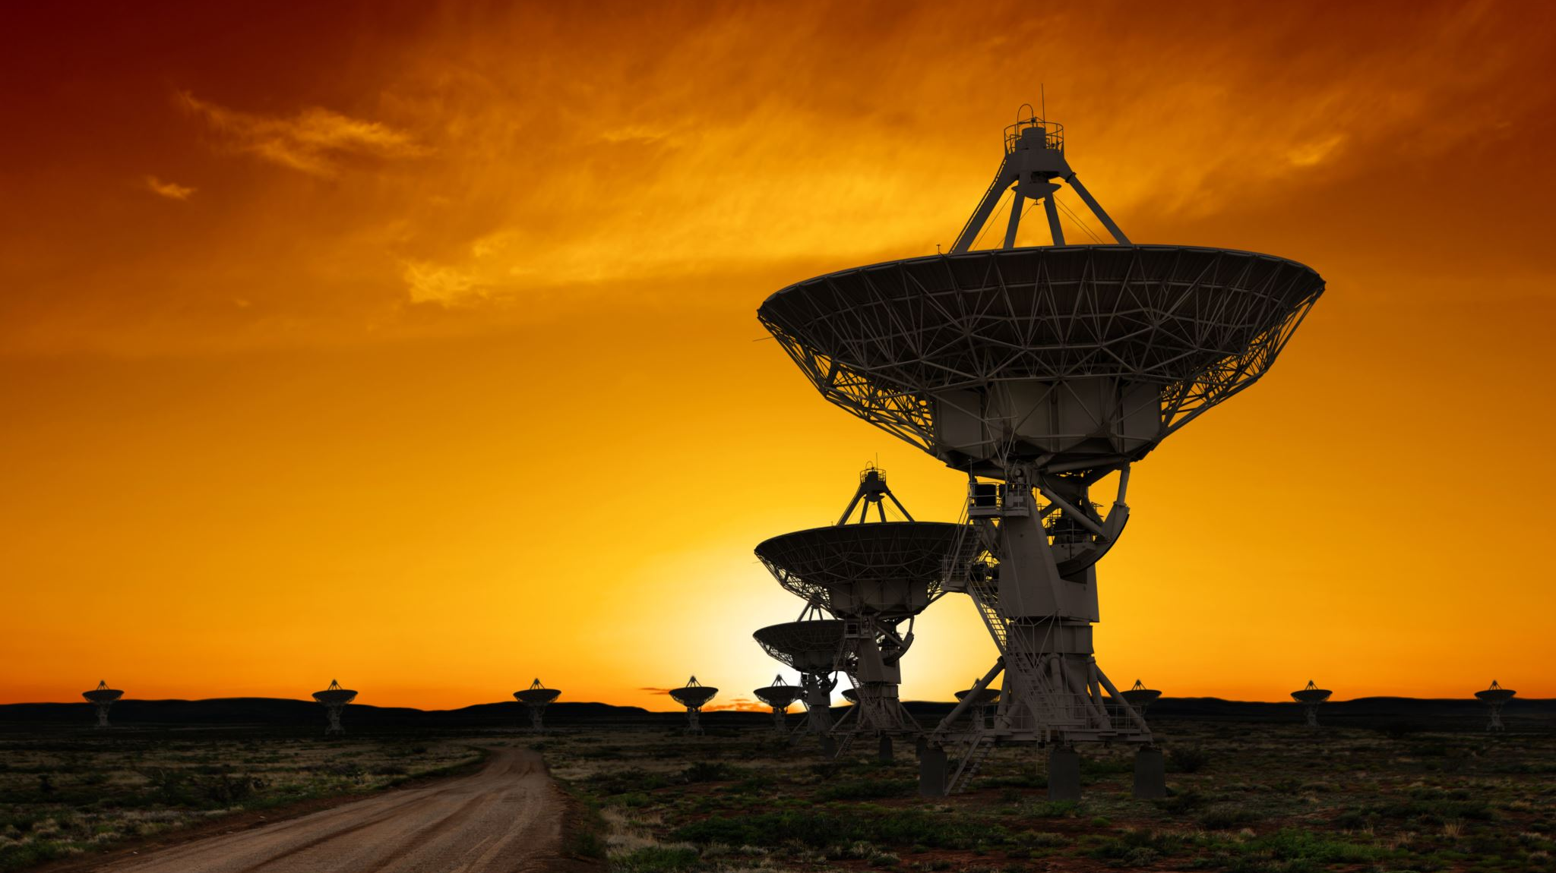
Ufo sightings
Project 3 Group 6
Samrawit Basazinew
Eugenia Chien
Drew Garza
Ben Rosensweig

Slide 2
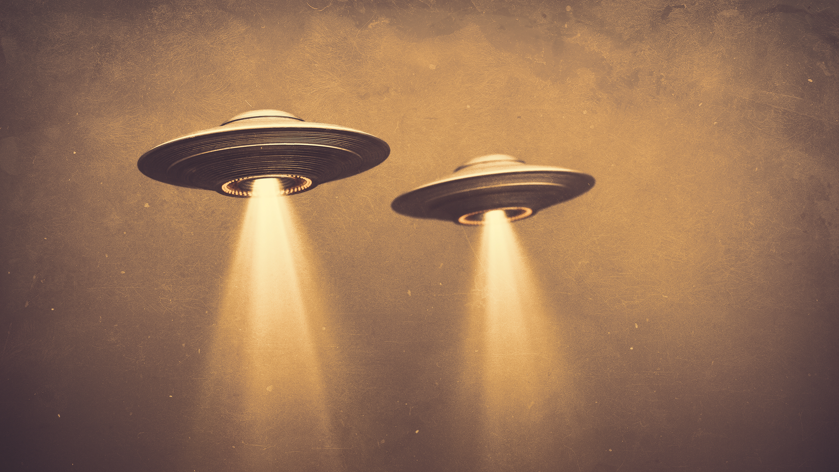


Agenda
Introduction of Dataset
Design Concepts
Research Questions
Live Demo
Analysis & Conclusion
Limitations & Bias
Future work

Slide 3
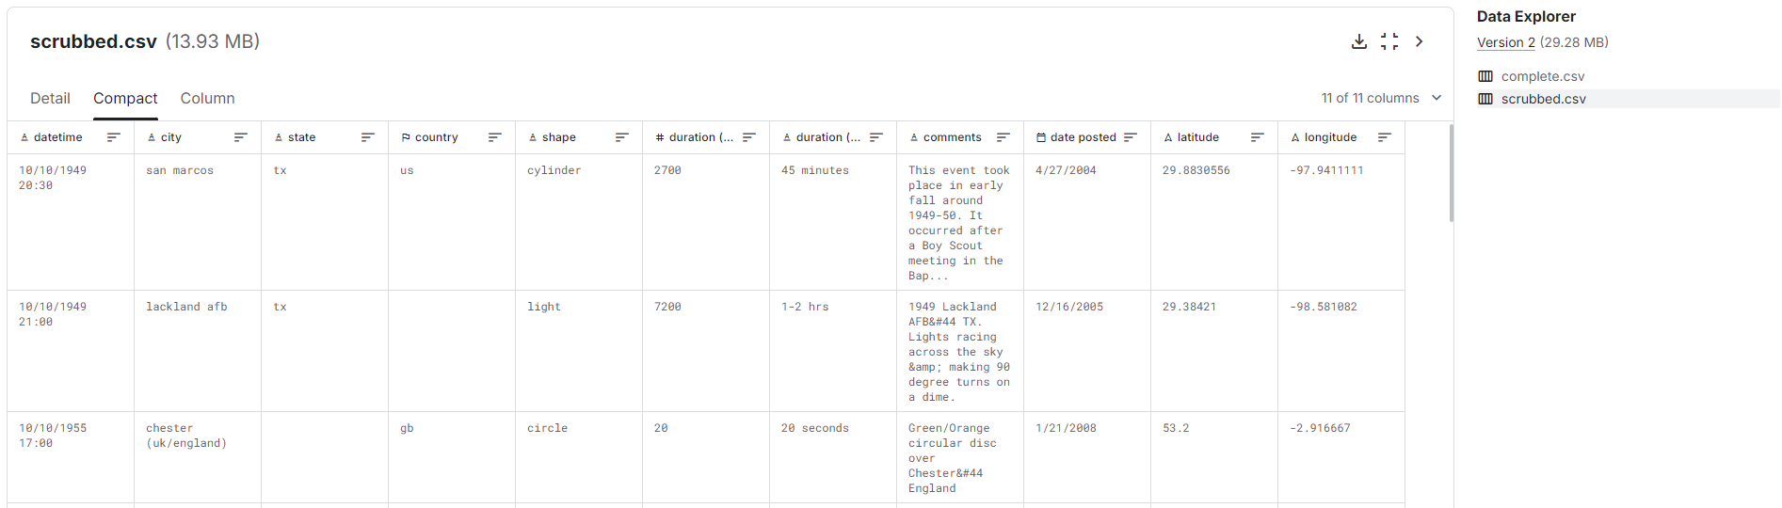
Dataset Link to Dataset
Kaggle CSV file already scrubbed
This dataset contains over 80,000 reports of UFO sightings over the last century.
Data engineering:
Light cleaning to remove nulls
Filter on U.S.
Filtered on shapes that were significant to data
Filtered on year > 1994

Slide 4
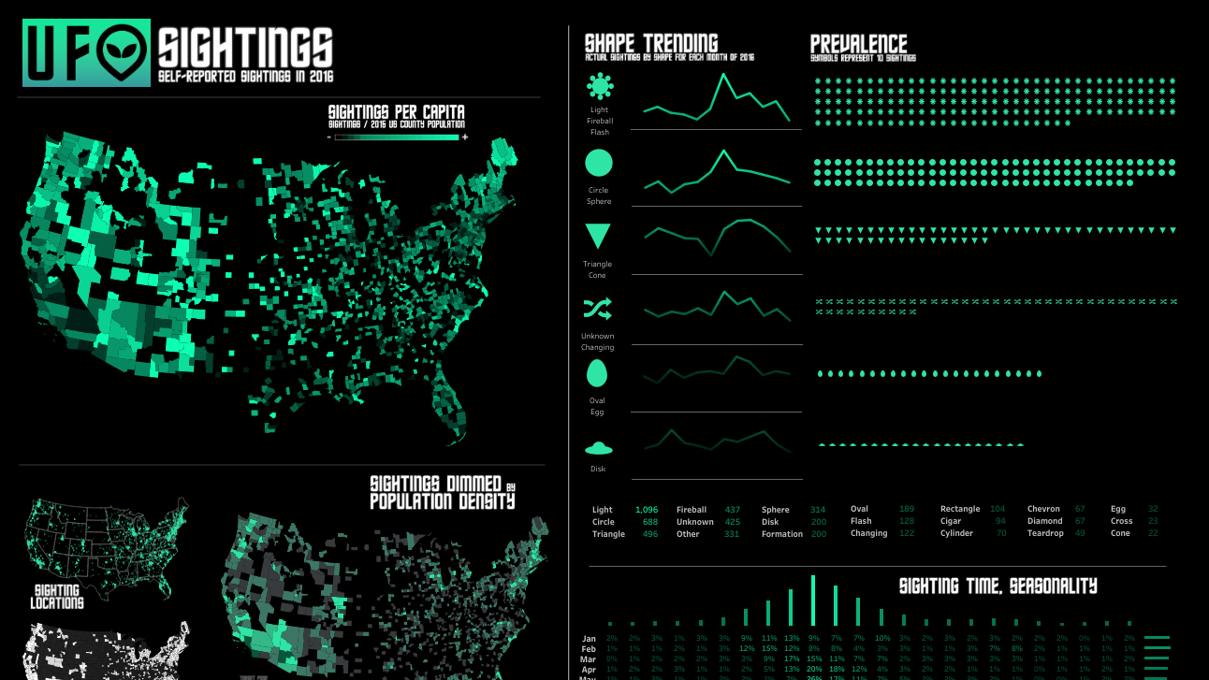
Design concepts
Credit : Ken Flerlage
Link to Ken Flerlage Website

Slide 5

Color scale
Greens
Link to Plotly Colorscale

Slide 6
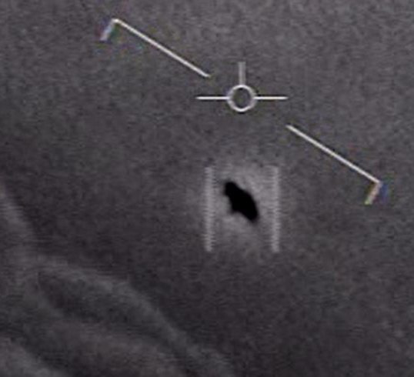
Research questions
What areas of the United States are most likely to have UFO sightings?
What days of the week and time of day do UFO sightings tend to occur?
What months / years have the highest occurrences of UFO sightings?
What is the distribution of shapes observed from UFO sightings?

Slide 7
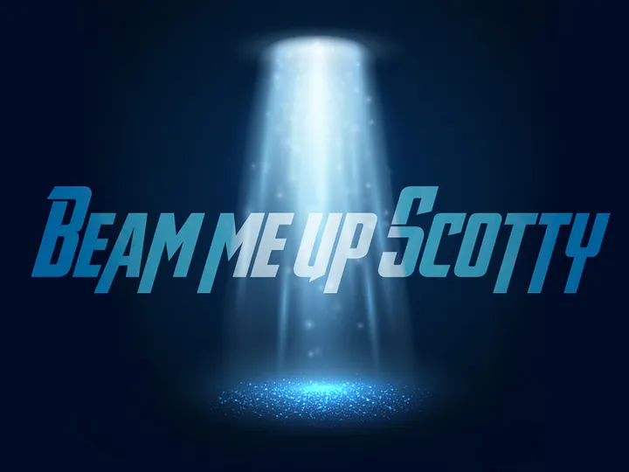

Click me to go along for the ride!

Slide 8


Analysis / conclusions
1994 thru 2014, California had most sightings of UFOs – 8,081 or 13.8% of all 50 states. Concentrated in Los Angeles area, and mostly in year 2012.
Sightings steadily increasing since 1994, peaking in 2012.
July had the highest number of sightings – 6,605 or 11.3% between 1994 – 2014.
Saturday had the most sightings 10,419 or 17.8% and Monday the least 7,275 or 12.4%
Sightings mostly between 6pm and 1am, peaking at 9pm
Out of the 7 categories of shapes, Luminous was by far the highest with 18,754 or 32% vs the next highest of Circular with 12,438 or 21.2%. Formations had the lowest at 1,874 or 3.2%.

Slide 9
Limitations and bias
Limitations
Lack of contextual information
Nearby Air Force bases conducting exercises, weather phenomena such as ball lightning, and celestial objects and events, including human-made ones, such as satellites and the International Space Station.
Individual beliefs. Could compare those who were convinced the sighting was an alien spacecraft to those who simply did not know what they were seeing.
Bias
All sightings were self-reported; could lead to inaccurate predictions.
No way to verify an observation

Slide 10
Future Work
Any future work would address these aforementioned biases and limitations.
Find a dataset that was conducted by a reputable agency.
Sightings could be cross-referenced with coincidental events and phenomena such as weather events and military exercises.
A simple interview exploring pre-existing personal convictions would also help contextualize the data.

Slide 11
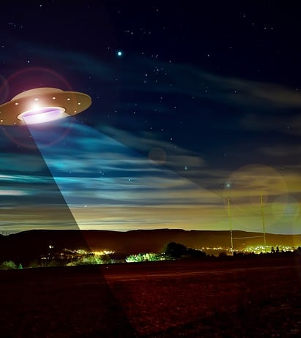
Thank you
DATA-PT-EAST-APRIL-041524-MTTH-CONS

